Slide 1
Exception and Event Handling
(Based on:Concepts of Programming Languages, 8th edition, by Robert W. Sebesta, 2007)

Slide 2
Basic Concepts in Exception Handling I
In the course of a program’s execution, many events may occur that were not expected by the programmer.
We distinguish between two such classes of events:
  Those that are detected by hardware: e.g., disk read errors, end-of-file
  Those that are software-detectable: e.g., subscript range errors

Slide 3
Basic Concepts in Exception Handling II
Definition: An exception is an unusual event that is detectable by either hardware or software and that may require special processing.
Terminology: The special processing that may be required when an exception is detected is called exception handling. The processing is done by a code unit or segment called an exception handler. An exception is raised when its associated event occurs.

Slide 4
User-Defined Exception Handling
When a language does not include specific exception handling facilities, the user often handles software detections by him/herself.
This is typically done in one of three ways:
  Use of a status variable (or flag) which is assigned a value in a subprogram according to the correctness of its computation. [Used in standard C library functions]
  Use of a label parameter in the subprogram to make it return to different locations in the caller according to the value of the label. [Used in Fortran].
  Define the handler as a separate subprogram and pass its name as a parameter to the called unit. But this means that a handler subprogram must be sent with every call to every subprogram.

Slide 5
Advantages to Built-in Exception Handling
Without built-in Exception Handling, the code required to detect error conditions can considerably clutter a program.
Built-in Exception Handling often allows exception propagation. i.e., an exception raised in one program unit can be handled in some other unit in its dynamic or static ancestry. A single handler can thus be used in different locations.
Built-in Exception Handling forces the programmer to consider all the events that could occur and their handling. This is better than not thinking about them.
Built-in Exception Handling can simplify the code of programs that deal with unusual situations. (Such code would normally be very convoluted without it).

Slide 6
Illustration of an Exception Handling Mechanism
  void example ( ) {
  …
  average = sum / total;
  …
  return;
  /* Exception handlers */
  When zero_divide {
  average = 0;
  printf(“Error-divisor (total) is zero\n”);
  }
  …
  }
The exception
of division by
zero, which is
implicitly raised
causes control
to transfer to the
appropriate
handler, which
is then executed

Slide 7
Design Issues for Exception Handling I: Exception Binding
Binding an exception occurrence to an exception handler:
  At the unit level: how can the same exception raised at different points in the unit be bound to different handlers within the unit?
  At a higher level: if there is no exception handler local to the unit, should the exception be propagated to other units? If so, how far? [Note: if handlers must be local, then many need to be written. If propagation is permitted, then the handler may need to be too general to really be useful.]

Slide 8
Design Issues for Exception Handling II:Continuation
After an exception handler executes, either control can transfer to somewhere in the program outside of the handler code, or program execution can terminate.
  Termination is the simplest solution and is often appropriate.
  Resumption is useful when the condition encountered is unusual, but not erroneous. In this case, some convention should be chosen as to where to return:
    At the statement that raised the exception?
    At the statement following the statement that raised the exception?
    At some other unit?

Slide 9
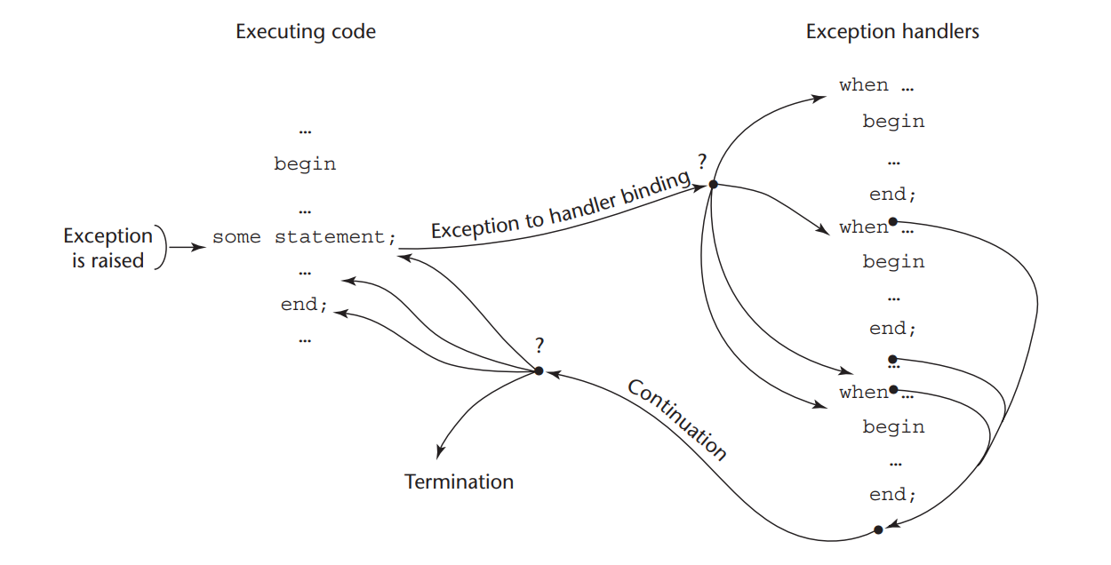

Slide 10
Design Issues for Exception Handling III: Others
Is finalization—the ability to complete some computations at the end of execution regardless of whether the program terminated normally or because of an exception—supported?
How are user-defined exceptions specified?
Are there pre-defined exceptions?
Should it be possible to disable predefined exceptions?
If there are pre-defined exceptions, should there be default exception handlers for programs that do not provide their own?
Can pre-defined exceptions be explicitly raised?
Are hardware-detectable errors treated as exceptions that may be handled?

Slide 11
Exception Handling in Java: Class Hierarchy for Exceptions
Throwable
Error
Exception
Run Out of
Heap Memory
Runtime
Exception
IO
Exception
Out of Bound
Exception
Usually thrown by
JVM when a user
program causes
an error
Errors thrown by the JVM
Errors never thrown by user programs
and should never be handled there
Null Pointer
Exception

Slide 12
Exception Handling in Java: Exception Handlers
A try construct includes a compound statement called the try clause and a list of exception handlers:
      try {
      //** Code that is expected to raise an exception }
      catch (formal parameter) {
      //* A handler body
      }
      …
      catch (formal parameter) {
      //** A handler body
      }

Slide 13
Exception Handling in Java: Binding Exceptions to Handlers
An exception is thrown using the throw statement.
  E.g.: throw new MyException (“a message to specify the location of the error”)
Binding: If an exception is thrown in the compound statement of a try construct, it is bound to the first handler (catch function) immediately following the try clause whose parameter is the same class as the thrown object, or an ancestor of it. If a matching handler is found, the throw is bound to it and it is executed.

Slide 14
Exception Handling in Java: The finally clause
Sometimes, a process must be executed regardless of whether an exception is raised or not and handled or not.
This occurs, for example, in the case where a file must be closed or an external resource released, regardless of the outcome of the program.
This is done by adding a finally clause at the end of the list of handlers, just after a complete try construct.
The finally clause is executed in all cases whether or not try throws an exception, and whether or not it is caught by a catch clause.

